Slide 1
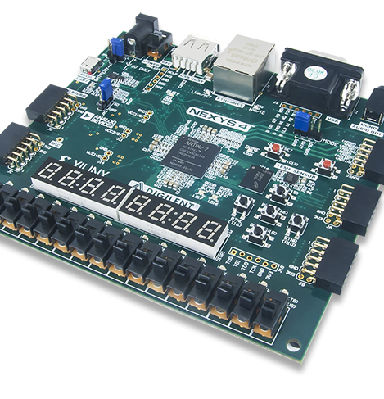
Lab 4
Group_D:
Laurice Sattouf
Choi Tim Anthony Young
Dimitri Garcia
Professor:
Mohamed El-Hadedy
California Polytechnic State University Pomona, California

Slide 2
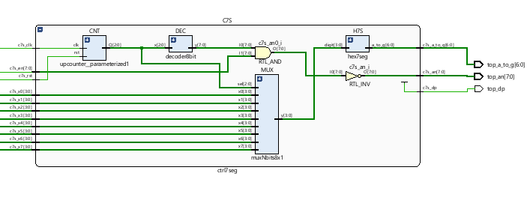
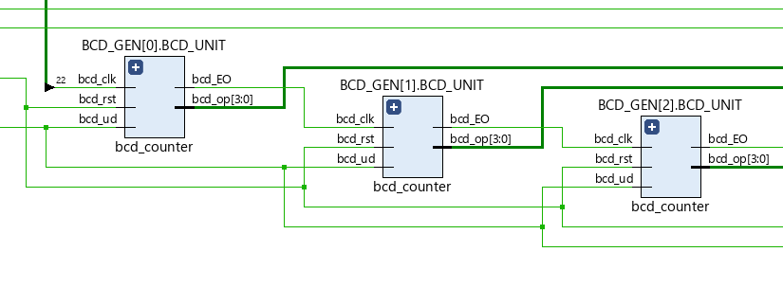
Assignment
Design a BCD counter counting up and down based on the value specified on an input switch.
Use all the displays available (8 units) of the BCD to display the results.
Design the implementation with two different reset buttons so that we could reset the counter or the displays separately.
Define all possible corner cases using a testbench textio.

Slide 3
Coding Steps
Step1
Design the component of BCD counter and make it generic so that we could create all 8 unites of the counter (16 digits total) using the original component.
Step2
Apply the coding techniques to develop the cascaded counter
Step 3
Use the 7-segment display which contains the following: Clock divider, The decoder, The Multiplexer, and BCD to segments units.

Slide 4
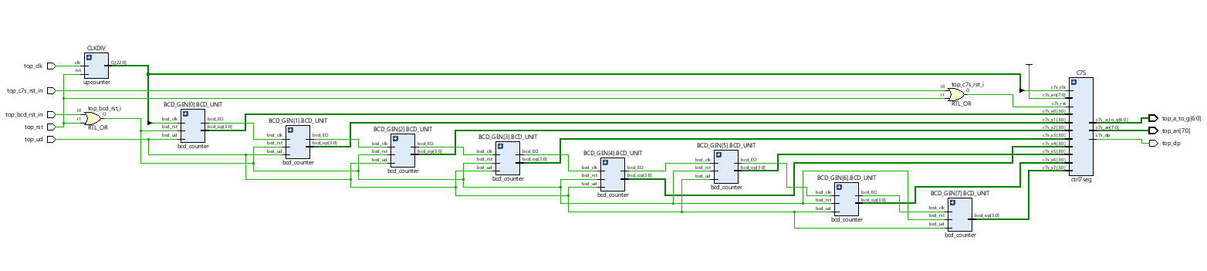
Schematic

Slide 5
Power and Resources

Slide 6

Work Distribution
We had a meeting to brainstorm and explain the main idea of the lab, and we created the schematic so that everyone would work individually to achieve the most optimized design.
We had a zoom meeting to choose the design with less power consuming, then we were able to demo our implemented design and cover all the corner cases.
Documentation and reports were evenly distributed, and it covered all the steps of our successfully implemented design.

